Slide 1
Investor Presentation
November 2022 Conferences

Slide 2
Safe Harbor Statement
The Company’s consolidated operating results are affected by a wide variety of factors that could materially and adversely affect revenues and profitability, including the risk factors described in Item 1A of our 2021 Annual Report on Form 10-K. As a result of these and other factors, the Company may experience material fluctuations in future operating results on a quarterly or annual basis, which could materially and adversely affect its business, consolidated financial condition, operating results, and common stock prices. Furthermore, this document and other documents filed by the Company with the Securities and Exchange Commission (“SEC”) contain certain forward-looking statements under the Private Securities Litigation Reform Act of 1995 (“Forward-Looking Statements”) with respect to the business of the Company. Forward-Looking Statements are necessarily subject to risks and uncertainties, many of which are outside our control, that could cause actual results to differ materially from these statements.
Forward-Looking Statements can be identified by such words as “anticipates,” “believes,” “plan,” “assumes,” “could,” “should,” “estimates,” “expects,” “intends,” “potential,” “seek,” “predict,” “may,” “will” and similar references to future periods. All statements other than statements of historical facts included in this report regarding our strategies, prospects, financial conditions, operations, costs, plans and objectives are Forward-Looking Statements. These Forward-Looking Statements are subject to certain risks and uncertainties, including those detailed in Item 1A of our 2021 Annual Report on Form 10-K, which could cause actual results to differ materially from these Forward-Looking Statements. The Company undertakes no obligation to publicly release the results of any revisions to these Forward-Looking Statements which may be necessary to reflect events or circumstances after the date hereof or to reflect the occurrence of unanticipated events. Any Forward-Looking Statement made by the Company is based only on information currently available to us and speaks only as of the date on which it is made.

Slide 3
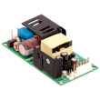
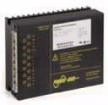
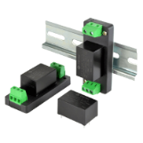
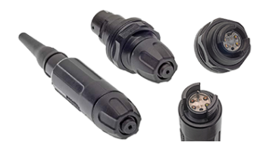
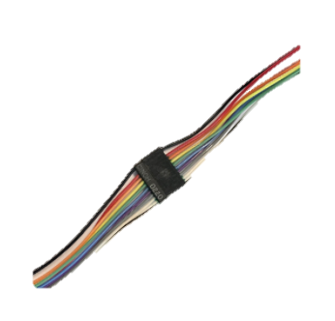
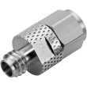
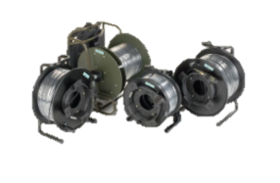
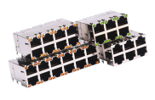
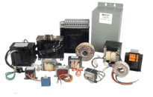
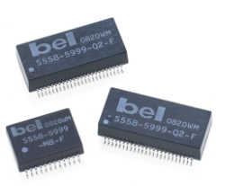
Bel at a Glance
Powering, protecting and connecting electronic circuits since 1949
Power Solutions & Protection
(40% of Net Sales)
Connectivity Solutions
(30% of Net Sales)
Magnetic Solutions
(30% of Net Sales)
$632M*
Sales
27.0%*
Gross Margin
11.6%*
Adj EBITDA Margin
OEM
* Trailing twelve months ended 9/30/22

Slide 4
Multi-Pronged Strategy for Sustained Growth
Where Have We Come From?
Where Are We Going?
70+ year legacy
$500M
in sales
Reputable Brands
Diversified End Markets
New ERP System
History
of M&A
Quality & Expansion of Revenue
Double down on high-growth and emerging markets
Focus on quality relationships with the right customers
Play for favorable positioning on product designs
Sharpen pricing strategies and practices
Optimization & Simplification
People and Culture as a Differentiator
Operational and Process Improvement
De-emphasizing some revenue/products
Bel is strategically positioned to create value through margin improvement and a focus on key markets and customers

Slide 5
Bel is in a Period of Change – Our journey thus far…
Actions Completed/In Process
Executive Changes
Farouq Tuweiq - New CFO (Feb 2021)
Kenneth Lai - New VP Asia Operations (Jan 2022)
Jackie Brito - New addition to Bel’s Board (Oct 2021)
Key Hires / Promotions
Sabine Muehlberger - New European Sales Director (April 2022)
Ping Gencianeo - New Global ESG Director (Oct 2022)
Refining Pricing Strategies
ERP Rollout & Data Clarity
Development of Corporate Strategy
Doubling Down on our Investment in People
Led to impressive Q3 results…
Record sales: $178M
Record Adj EBITDA: $27M
Record EPS: $1.48 (Class B, non-GAAP)
Lowest leverage since 2014: 1.21x
YTD increase in stock price*:
BELFA: ~115% increase
BELFB: ~160% increase

Slide 6
The Next Stage of Our Journey…
Actions Kicked Off in Q3-22:
Footprint Simplification
China: 2 locations/9 buildings – consolidate into a single centralized facility in Southwestern China
U.S.:
Manufacturing in Tempe, AZ and Melbourne, FL transitioning to existing facility in Waseca, MN
Corporate office in Jersey City, NJ: two building sales (one complete in Q3-22; one pending for H1-23)
Europe: Facility in Sudbury, UK to consolidate into existing facility in Chelmsford, UK
Formalization of ESG Structure
Development of internal ESG committee
Board-level oversight through creation of Nominating & ESG Committee at Board level
With the goal of…
Simplifying the way we do business
Streamlining our overhead structure
Optimizing our operational footprint
Being a better corporate citizen
Minimizing our impact on the environment
Giving back to our global communities
More to come…stay tuned as our journey continues

Slide 7
Tailwinds from Key Sector Fundamentals
Increased Data Generation
5G / Connectivity
Exponential Technological Advancement
EV and Infrastructure
Electrification
Miniaturization
Positive end market trends position Bel for long-term success

Slide 8
Diverse End Markets…
Network & Cloud
Military & Aerospace
Industrial/EV
Distribution
36%
11%
20%
33%
other markets
other markets
other markets
IOT  5G  Automation
Space
Agriculture  Medical
Sales by End Market based on management estimates

Slide 9
…at an Exciting Sectoral Inflection Point
 | End Market | Recent Demand | Outlook | Commentary
 | Distribution | ⇒ | ⇒ | Extends our global reach Mix of customers early in design cycle Broad end customer/market diversity Expansion of private labeling business
 | General Industrial |  |  | Rail: long life cycle; heavily dependent on government spending Test & Measurement Automation
 | Emerging/High-Growth Markets | ⇒ | ⇒ | EV: Market leader with over 200 NDA’s signed Space: emerging end market
 | Military & Aerospace | ⇒ | ⇒ | Military: expected upside from increased spending Aerospace: in early innings of rebound cycle with further ramp up expected in next 12-18 months. Rms acquisition strengthens our position.
 | Network & Cloud | ⇒ | ⇒ | Significant growth in data generation, storage and transmission Proliferation of IoT, automation and smart applications

Slide 10
Bel’s Segment Overview
End Markets | Cinch Connectivity Solutions | Power Solutions & Protection | Magnetic Solutions
Applications | Military and Aerospace Industrial Data Communications Transportation Construction (premise wiring) Oil and gas | Networking and data storage Industrial Rail Lighting Medical Electric vehicles and equipment Consumer | Data and Telecommunications (Networking Infrastructure Switching, Servers and Storage Devices) Industrial Medical Alarm and Security Systems Lighting Home Networking
Select Products | Harsh Environment Fiber Optics Connectors and Cable Assemblies – optical, fiber, circular Applications specific | Front-end (AC-DC) power supplies Board mount power (BMP) Industrial power products e-Mobility converters and inverters Circuit protection | Integrated Connector Modules (ICMs) Power Transformers Power Inductors Discrete Components
Customers
Financial Overview
Revenue
Gross Margin

Slide 11
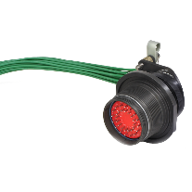
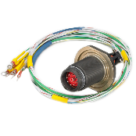
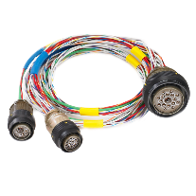
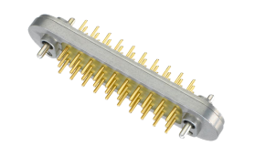
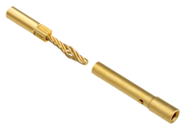
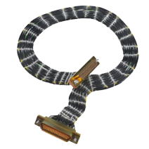
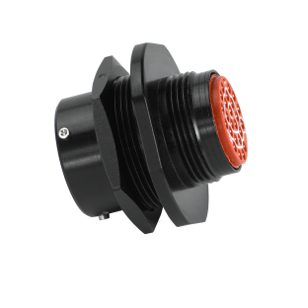
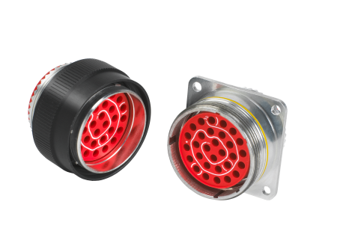
Case Study: Commercial Aerospace
FQIS (7)
(used in fuel tank to monitor fuel quantity)
Dura-Con (4)
(used in navigation controls; carries both power and signal)
Omega (5,500)
(general avionics connector for power and signal; used throughout aircraft – undercarriage deployment hydraulics, flight controls, navigation, mechanical systems and lighting)

Slide 12
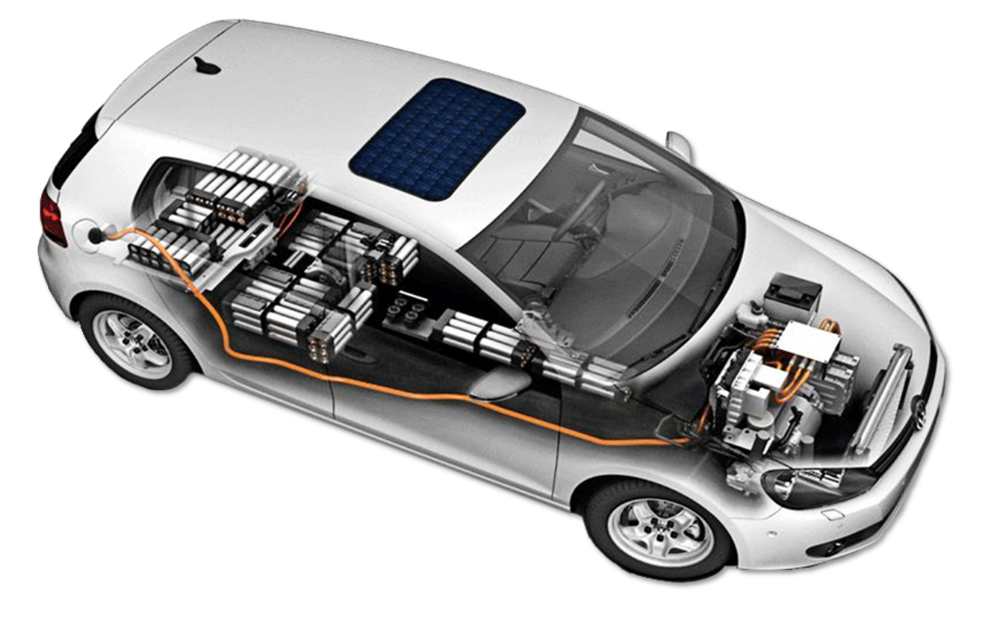
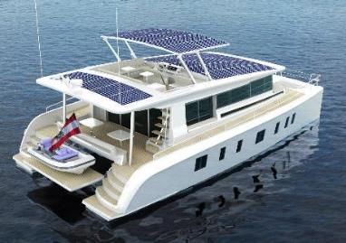
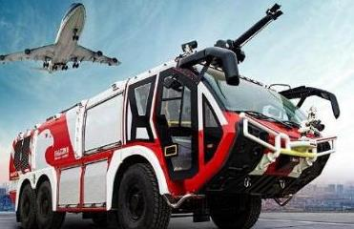
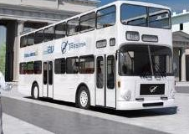
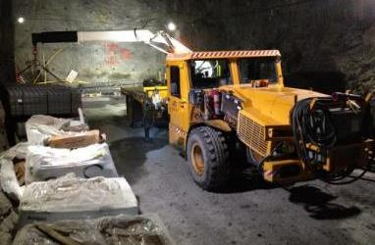
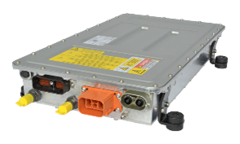
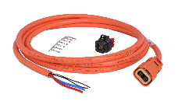
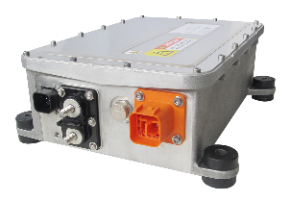
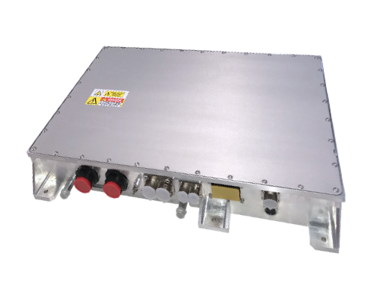
Case Study: eMobility
Fuses
Agriculture & Farm Equipment, Buses, Food Trucks, Hybrid & Electric Vehicles, Light Duty Commercial Vehicles, Marine & Boats, Medium & Heavy-Duty Commercial Vehicles, Off Road Vehicles, Work Trucks
Power Conversion
Battery Charging
Cable
Assemblies
Auxiliary Power
Ranges from $1,500-$15,000 of Installed Power per Vehicle
Featured Products

Slide 13
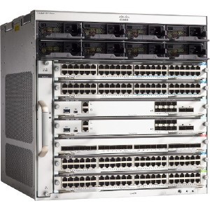
Case Study: Cisco 9400
The Catalyst 9400 Series is the next generation of the industry's most widely deployed enterprise switching platform… These modular access switches are built for security, IoT, and cloud. They deliver state-of-the-art high availability, support up to 9 Tbps, provide the latest in 90-watt UPOE+, and form one of the building blocks for SD-Access, Cisco's leading enterprise architecture.
- Cisco website
Internal Board level components:
Fuses
DC/DC isolated board mount converters
DC/DC point-of-load converters
Passive jack communications ports
Multiport ICMs
1G to 10G port speeds
15-90W PoE capability

Slide 14
Historical Financial Performance
Historical Revenue / GM%
Historical Adjusted EBITDA
($ in millions)
$633
($ in millions)
$567
$548
$543
$500
$491
$493
$466
Debt / Cash / Net Leverage
Historical Capital Expenditures
($ in millions)
($ in millions)
Paid down to $100M at 10/31/22

Slide 15
Quarterly Trend
1st Quarter
2nd Quarter
3rd Quarter
4th Quarter
2020
Margins favorably impacted by tariff refunds and Chinese subsidies (COVID)
Millions
Q2-21 / Q3-21
Margin compression on higher sales as pricing does not yet reflect higher material costs.
Q4-21
Margin expansion on higher sales as new pricing starts to take effect in Q4-21
2022
Global focus on margins and proper pricing at SKU level beginning in Q1-22 has resulted in meaningful margin expansion. Margins also aided by favorable FX (RMB) in 2022 periods.
Sales
2019
2020
2021
2022
¹ These financial measures exclude the impact of costs associated with restructuring activities, acquisition-related costs and gain on sale of properties.

Slide 16
Backlog by Product Group
Backlog levels are a function of demand and lead times
Lead times:
Backlog Commentary
Power:
EV bookings of $3M in FY2020; $50M in FY2021; $26M YTD Sept-22
Strong performance in fuses – more than 2.5x backlog from Dec 2020
Inclusion of EOS backlog of $16M at 9/30/22 (acquired Mar-21)
Magnetics:
Bookings down from networking customers as they shorten purchase commitment timeframe
Connectivity:
Continued rebound of commercial aerospace demand. Comm air bookings of $8M in FY2020; $21M in FY2021; $31M YTD Sept-22
Military bookings strong in Q2/Q3-22 indicate pickup in future sales volume (bookings of $37M in FY2020, $44M in FY2021, $39M YTD Sept-22)
Premise wiring demand at 3-year high (passive connectors/cabling products)
52+ weeks

Slide 17
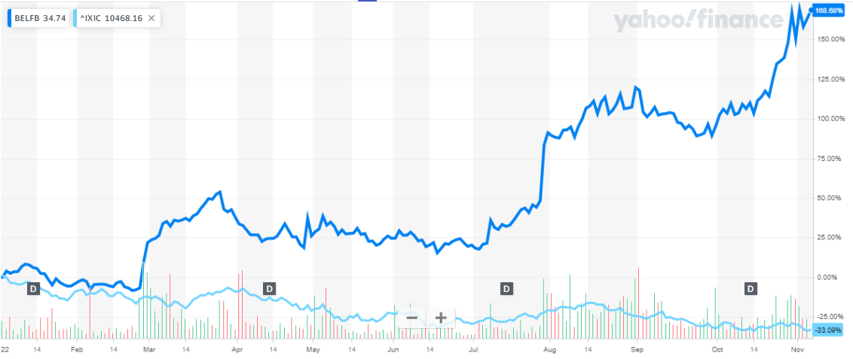
Share Information
Key Statistics (as of 11/3/22)
Shares outstanding
12.5M
Market cap
$420M
Enterprise value
$460M
NDQ: BELFA
voting
NDQ: BELFB
non-voting
Stock price
$32.06
Stock price
$34.04
Outstanding shares 2,142,000
Outstanding shares 10,338,000
Quarterly dividends $0.06 / share
Quarterly dividends $0.07 / share
20% held by insiders
3% held by insiders
BELFB: 169% increase in stock price YTD 2022 vs 33% decrease in full Nasdaq

Slide 18
Appendix

Slide 19
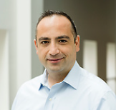
Today’s Presenters
Farouq Tuweiq
Chief Financial Officer
Lynn Hutkin
Director of Financial Reporting
Mr. Tuweiq became the Company’s Chief Financial Officer in January of 2021
Previously, Mr. Tuweiq worked at BMO Capital Markets, where he led and helped build the Industrial Technology Investment Banking practice
Mr. Tuweiq earned his BA in Finance and MS in Accounting from Michigan State and his MBA from Georgetown University
Ms. Hutkin joined Bel in 2007, was promoted to Director of Financial Reporting in 2017 and was additionally appointed as the Company’s Principal Accounting Officer and Secretary in 2021
Previously, Ms. Hutkin was Director of External Financial Reporting and Human Resources for CD&L, Inc.
Ms. Hutkin earned her BS of Accountancy from Bentley College and is an active CPA

Slide 20
Cinch Connectivity Solutions
Products
Sales by End Market¹
Harsh Environment Fiber Optics
- High-speed transceivers and media converters
Expanded beam optical connectors
Copper-based Connectors and Cable Assemblies:
- Mil-spec circular and rectangular
- RF (radio frequency) and Ethernet connectivity
Applications
Select Customers
Military and Aerospace
Industrial
Data Communications
Transportation
Construction (premise wiring)
Oil and Gas
Select Competitors
¹ Sales by End Market based on management estimates
² Data for trailing twelve months ended September 30, 2022 and 2021 ($ in millions)
³ Data as of December 31, 2021 and September 30, 2022 ($ in millions)

Slide 21
Power Solutions & Protection
Products
Sales by End Market¹
Front-end (AC-DC) power supplies
Board mount power (BMP)
Industrial power products
e-Mobility converters and inverters
Circuit protection
Applications
Select Customers
Networking and data storage
Industrial
Rail
Lighting
Medical
Electric vehicles and equipment
Consumer
Select Competitors
¹ Sales by End Market based on management estimates
² Data for trailing twelve months ended September 30, 2022 and 2021 ($ in millions)
³ Data as of December 31, 2021 and September 30, 2022 ($ in millions)

Slide 22
Magnetic Solutions
Products
Sales by End Market¹
Integrated Connector Modules (ICMs)
Power Transformers
Power Inductors
Discrete Components
Applications
Select Customers
Data and Telecommunications
(Networking Infrastructure Switching, Servers and Storage Devices)
Industrial
Medical
Alarm and Security Systems
Lighting
Home Networking
Select Competitors
¹ Sales by End Market based on management estimates
² Data for trailing twelve months ended September 30, 2022 and 2021 ($ in millions)
³ Data as of December 31, 2021 and September 30, 2022 ($ in millions)

Slide 23
Balance Sheet Highlights
$ in millions | September 2022 | December 2021
Cash | $71 | $62
Debt | 110 | 113
Equity | 236 | 209
Working Capital | 240 | 217
Current Ratio | 2.8 to 1 | 2.9 to 1
Inventory Turns (excl R&D) | 3.1x | 3.1x
DSO | 53 days | 54 days
Leverage Ratio | 1.21x | 2.11x
*
* The Company made a voluntary paydown of $10M in October, bringing debt balance down to $100M at 10/31/22

Slide 24
Global Presence
62% of sales
13% of sales
25% of sales
NORTH AMERICA 8 Manufacturing Sites 7 Sales Offices 9 Research & Design Centers
EUROPE 3 Manufacturing Sites 5 Sales Offices 5 Research & Design Centers
APAC 4 Manufacturing Sites 4 Sales Offices 6 Research & Design Centers

Slide 25
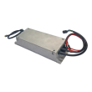
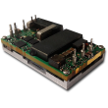
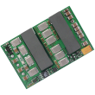
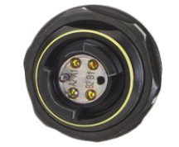
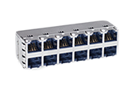
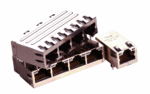
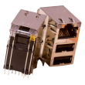
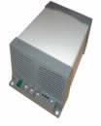
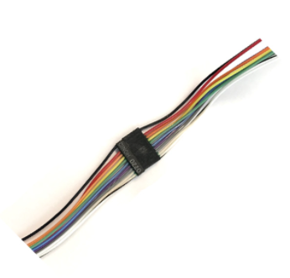
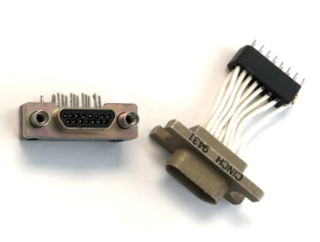
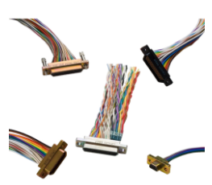
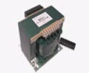
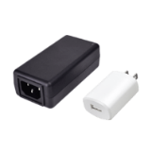
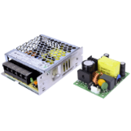
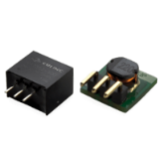
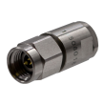
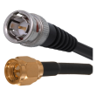
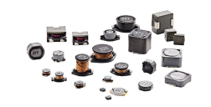
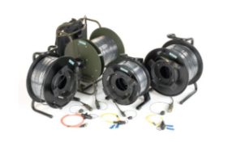
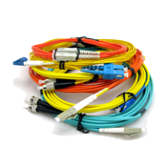
Product Set Overview
Power Solutions & Protection
(40% of Net Sales)
Connectivity Solutions
(30% of Net Sales)
Magnetic Solutions
(30% of Net Sales)
Front-Ends & Board-Mount Power
Passive Connectors
Integrated Connector Modules
Industrial
Connectors & Cable Assemblies
Power Transformers
External Power
RF Connectors / Microwave Components
Power Inductors & Transformers
Module & Circuit Protection
USB Connectors and Cable Assemblies
Discrete Components
The Bel family of products has provided innovative, application specific solutions and unparalleled service to diversified markets for ~70 years, establishing Bel as a world leader in Magnetics, Power Solutions & Protection and Interconnect

Slide 26
Bel’s ESG Journey: Underway
Environmental
Minimize our impact on the environment
Create a more sustainable tomorrow
Make changes big & small to reduce consumption
Social
Diversity and inclusion at all levels
All perspectives, opinions are encouraged to be heard
Giving back to our global community is a priority
Governance
Trust, integrity & accountability at all levels of the organization
Continual alignment of our policies, practices and priorities to align with the best interests of our associates, shareholders, and other stakeholders
Bel is committed to creating a better tomorrow by understanding how our actions impact the world around us.
We accomplish this through tangible steps, big and small, that can be taken to invest in our communities, minimize the impact to our environment and ensure alignment of interest of all parties.
As an organization that thrives on learning and continuous improvement, Bel welcomes and embraces this journey.

